Slide 1
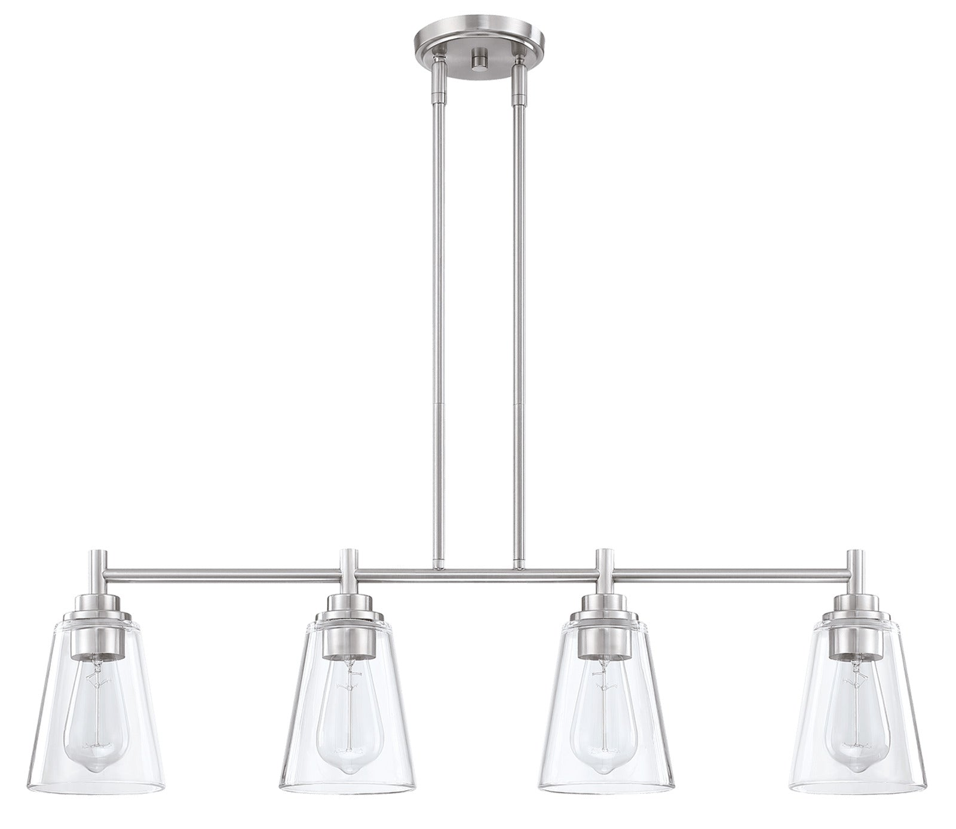
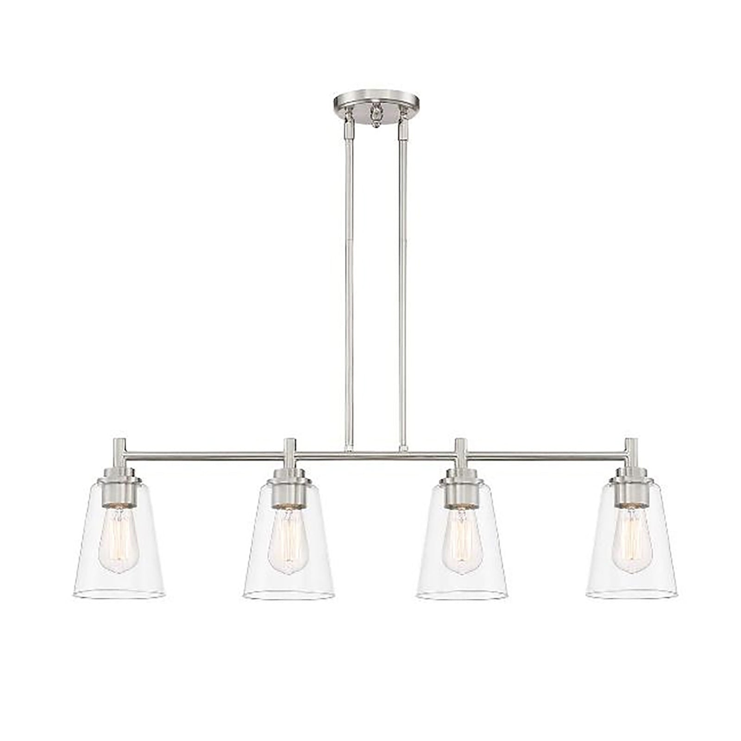
Bulb Lamp
SPECIFICATIONS
Model | MRCPD066
Size | 34 " L x 5-1/8" W x 8-7/8" H
Recommended base | E26,Bulb not Included
Number of Bulbs | 4
Primary Material | Steel + Glass
Finish | Brushed Nickel
Shade Material | Clear Glass
Location Rating | Damp
Certiﬁcations | cETLus

