Slide 1
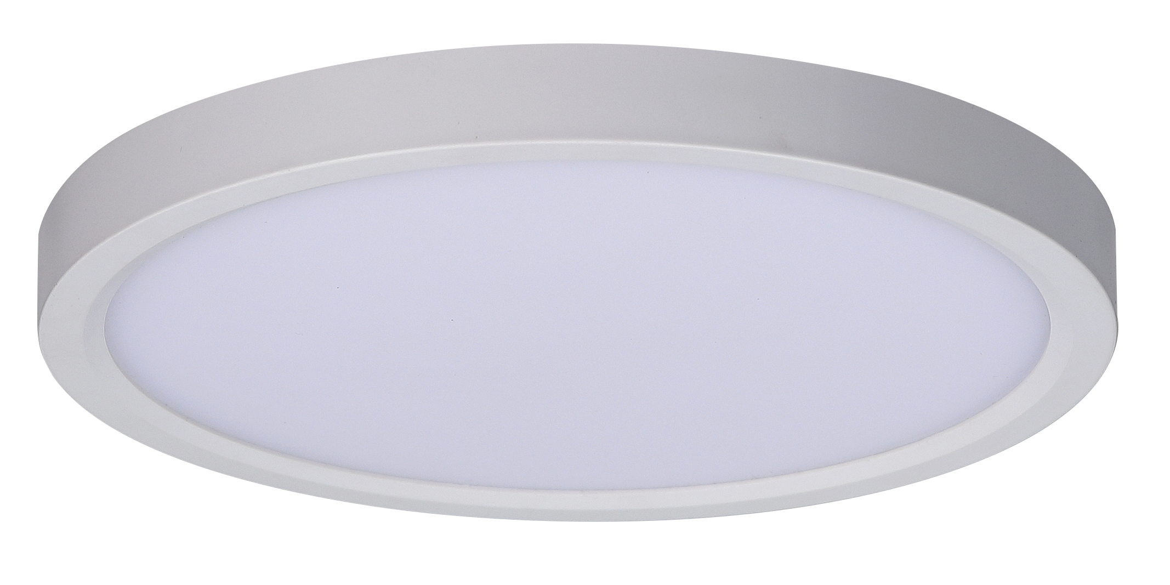
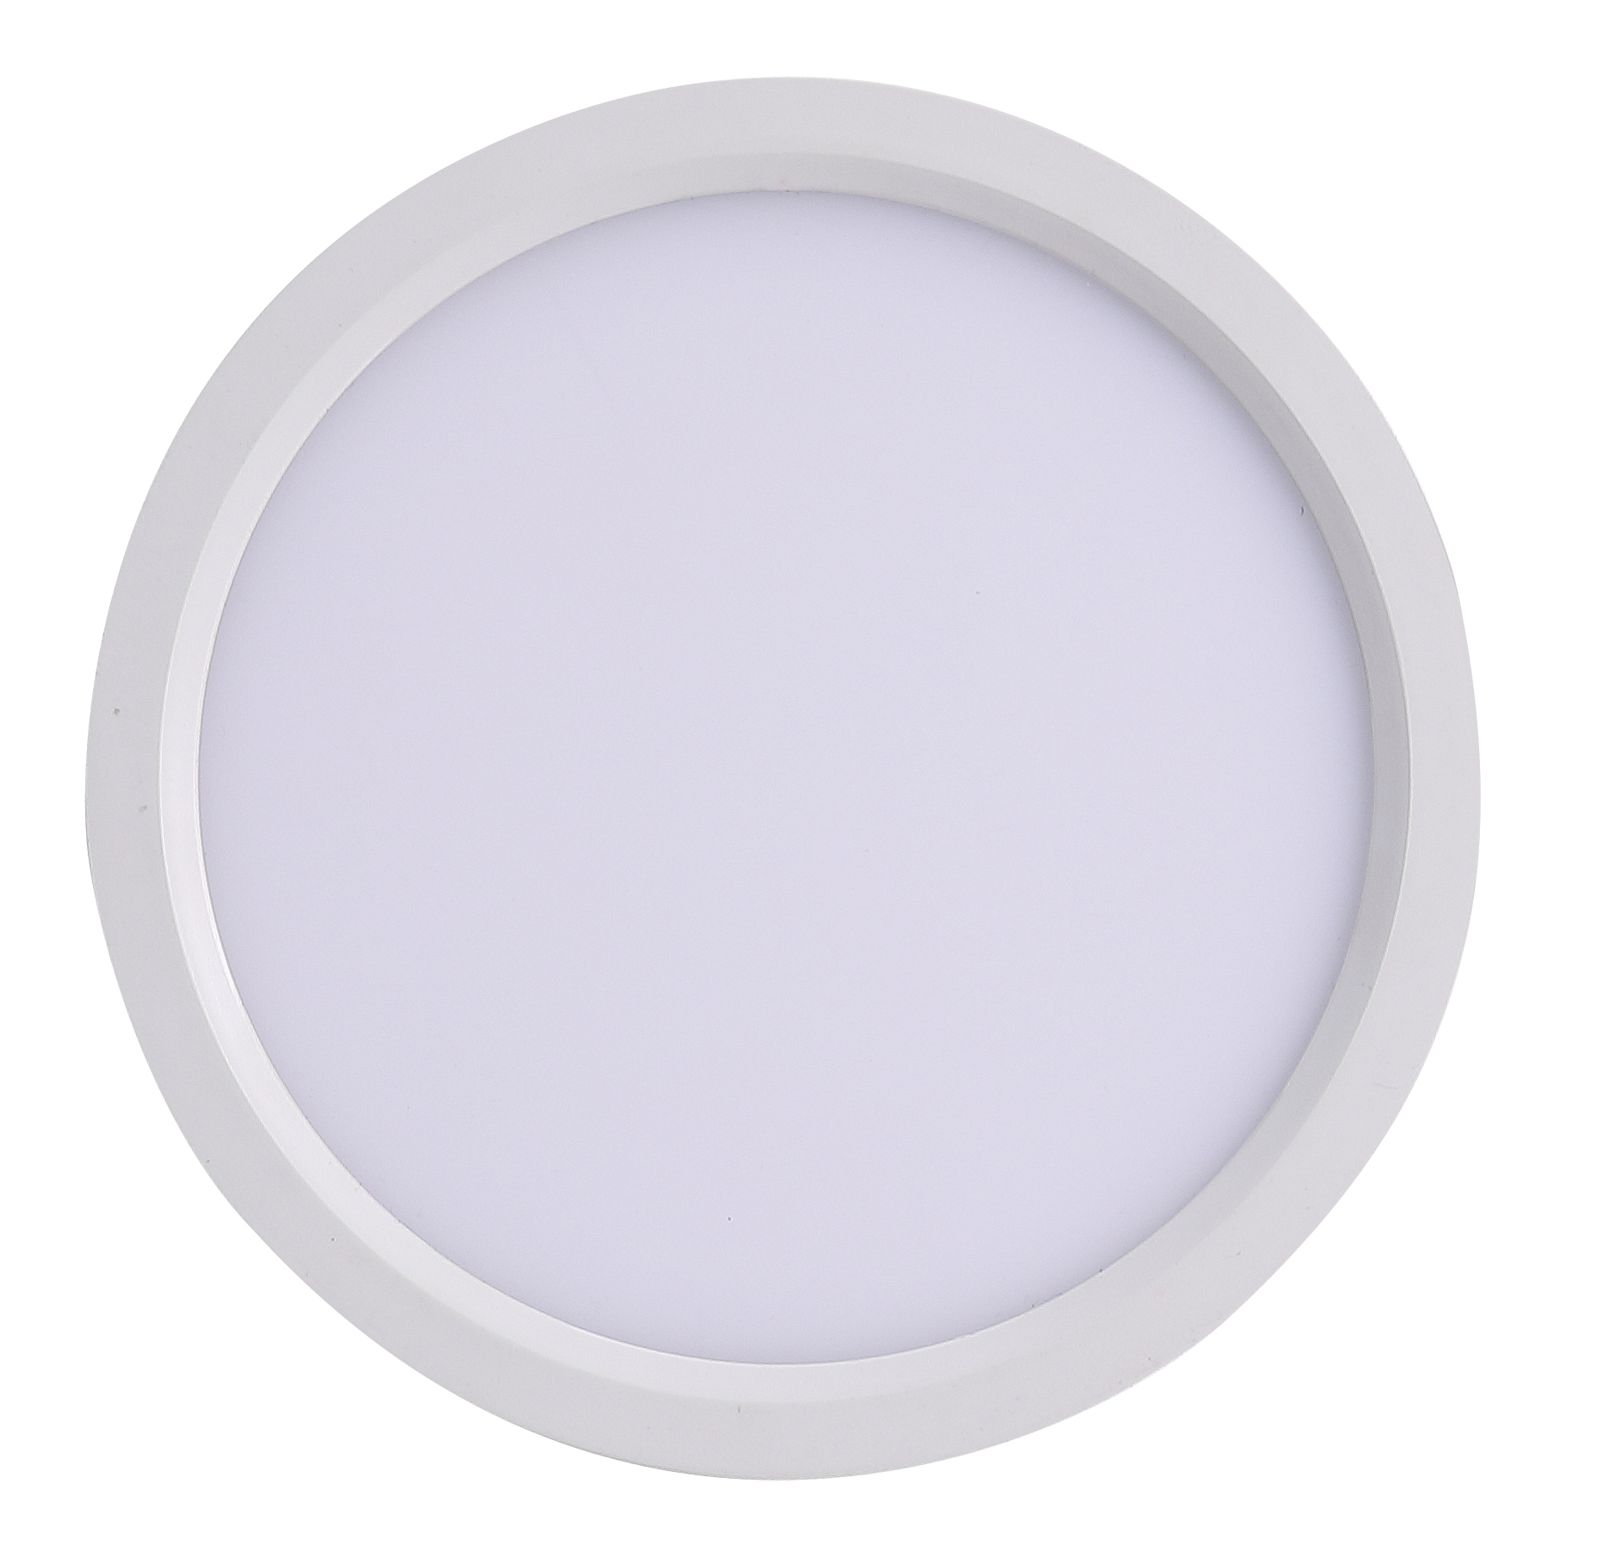
Integrated LED
SPECIFICATIONS
Model | MRLCL042055CD10MW
Size | D:5-1/2”*H:5/8”
Power Input | AC 120V 60HZ
Wattage (w) | 10W
CRI | >80
Lumen (lm) | 600lm
Color Temperature (K) | 2700/3000/3500/4000/5000
Location Rating | Damp
Finish | White
Primary Material | ABS + PS
Certiﬁcations | cETLus
Copy right of RisingSun Technology Co., Ltd., All right reserved.

